Slide 1
Somerset Berkley Regional High School
Robotics Engineering with LabView

Slide 2

  1. Engineering Design
  Central Concepts: Engineering design involves practical problem solving, research, development, and invention/innovation, and requires designing, drawing, building, testing, and redesigning. Students should demonstrate the ability to use the engineering design process to solve a problem or meet a challenge.
Ma.Science and Engineering Framework 2006

Slide 3
Standard 1.1
1.1 Identify and explain the steps of the engineering design process: identify the problem, research the problem, develop possible solutions, select the best possible solution(s), construct prototypes and/or models, test and evaluate, communicate the solutions, and redesign.
Identify the
problem
Redesign
Research the
problem
Communicate the
solutions
Develop solutions
Test and
evaluate
Select the best
solution
Construct a
prototype
Ma.Science and Engineering Framework 2006

Slide 4
Identify the
problem
Identify the problem in need of a solution.
The problem in this project is to create
a robot that can travel 20 feet and
come back the 20 feet as fast as
possible.
Ma.Science and Engineering Framework 2006

Slide 5

Research the
problem
Examine the current state of the issues and current solutions.
Student: I have discovered that the smaller and more compact the robot, the faster it will go.
Explore other options via the internet
Student: http://www.education.rec.ri.cmu.edu/roboticscurriculum/multimedia/buildquest3.shtml
Ma.Science and Engineering Framework 2006

Slide 6
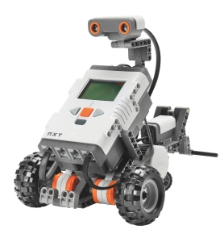
Develop solutions
Brainstorm
Student: A robot with three motors, a robot with two motors, and a robot with one motor that will make it travel faster.
Ma.Science and Engineering Framework 2006

Slide 7
Select the best
Possible solution(s)
Student: A robot with two motors best meets the problem
Because it will have a lot of torque, but will also be light and
compact enough.
Capture the conversation in GoAnimate.com
Ma.Science and Engineering Framework 2006

Slide 8
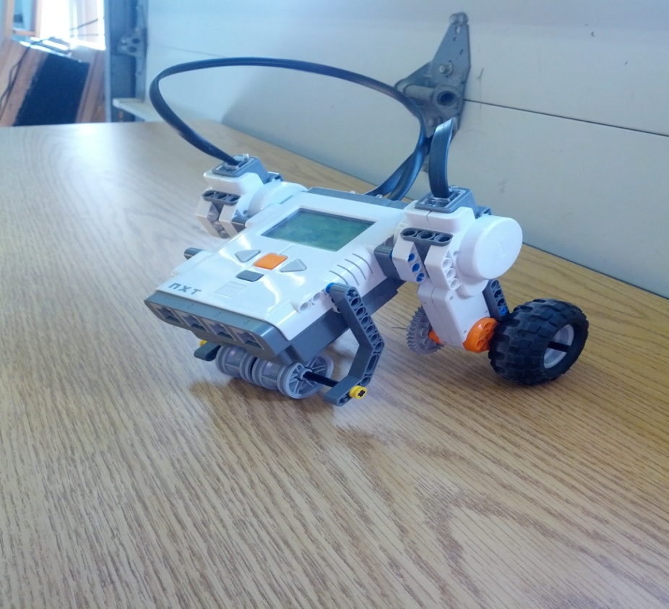
Construct a prototype
Student: Build a robot with your nxt lego kit(put first prototype)
Ma.Science and Engineering Framework 2006

Slide 9
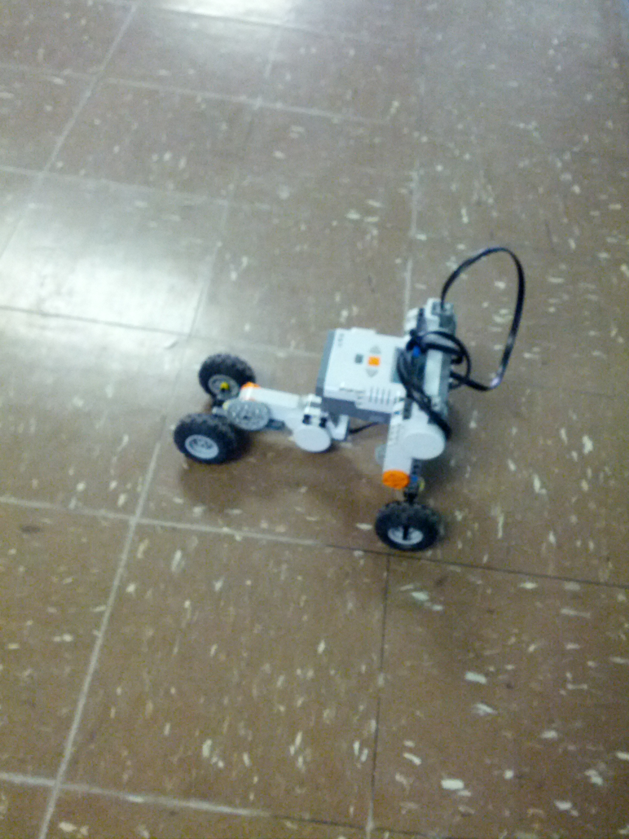

Slide 10
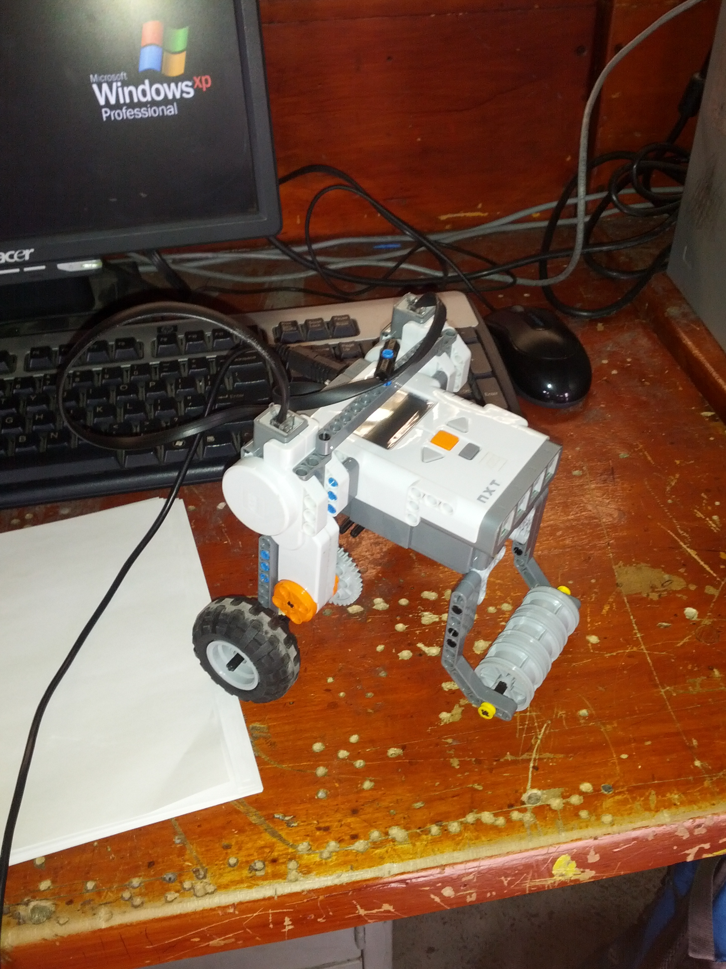

Slide 11

Test and Evaluate
the solution(s)
Does it work?
All solutions above work, but the question is which one is the fastest.
Does it meet the original design constraints?
All of the solutions meet the design.
Can it be manufactured?
They can all be manufactured.
Is it safe?
What happens to the products when its useful
life is finished?
It will always be useful.
Use GoAnimate.com
to respond to the questions
Ma.Science and Engineering Framework 2006

Slide 12
Communicate the solution(s)
Describe how the solution(s) best meet(s) the initial need
or problem
The last solution best meets the problem because it travels the total 40 feet the fastest (3.07 feet/second).
Publish your GoAnimate video!
Ma.Science and Engineering Framework 2006

Slide 13
..\Videos\20131125_101836.mp4
https://www.youtube.com/watch?v=O3nM8m9m2OU

Slide 14
Redesign
Overhaul the solution(s) based on information gathered
during testing and self-assessment activity.
Ma.Science and Engineering Framework 2006

Slide 15
